Slide 1


Agile Software Development
Dr. Michael Robbeloth
Teaching Demonstration
April 24, 2025

Slide 2
ACM CS Curricular Guidelines
Agile Software Development best fits within the Software Engineering Teamwork Knowledge Unit
Part of CS Core (2+3 hours) and/or KA Core (2 hours) Topics
Outcome :Explain the core values and principles of the Agile Manifesto and contrast them with traditional software development methodologies (like Waterfall)
Outcome: Describe key Agile practices such as iterative and incremental development, continuous feedback, and the role of self-organizing, cross-functional teams.
Outcome: Identify potential benefits and challenges of using an Agile approach in software development projects

Slide 3
ABET Learning Outcomes Covered
CS 5 Function effectively as a member or leader of a team engaged in activities appropriate to the program’s discipline
SE 3 An ability to communicate effectively with a range of audiences;
SE 5 An ability to function effectively on a team whose members together provide leadership, create a collaborative and inclusive environment, establish goals, plan tasks, and meet objectives;
SE 6 An ability to develop and conduct appropriate experimentation, analyze and interpret data, and use engineering judgement to draw conclusions;

Slide 4

Introduction
For decades, software engineers have learned the Waterfall model.
It is linear and plan-driven
Each phase in sequence, with all details spelled out before coding
Meant for large, dispersed teams in long-lived software systems
Too much overhead in small to medium collocated groups
For certain projects, there is a better way
One that handles technology, user needs, and market conditions that are constantly changing
That’s what we’ll explore today – the Agile model (helping developers thrive in an unpredictable environment)
Notes:
An example of this type of software is a control system for a modern aircraft.
Developing an avionic system might take five to ten years from initial specification to onboard deployment.
Too much time spent writing documentation that is likely to become out-of-date quickly
Developers in plan-driven systems often have to redo work in later phases at a huge cost due to mismatch in expectations between end-users and developers

Slide 5

Introduction
Agile is an alternative to approach to software development
Used quite regularly in industry today (though how well it is used is another story)
Understanding agile will help in advancing your career

Slide 6

Agenda
Setting the Stage: Traditional Methodologies vs Agile Methodologies
The Agile Manifesto and Core Values
Key Agile Principles and Practices
Benefits and Challenges of Agile
Conclusions and Q&A
Notes:
In the remainder of our talk, we will cover the following areas.

Slide 7

Setting the stage – Traditional Methodologies (Waterfall)
Rigid
Each stage must be completed before the next
Progress is like a waterfall
You don’t go back to a previous stage
Notes:
You don’t go back to a previous stage, but at great cost and rework of all previous stages.
Think about the salmon. It go fight against the currents going upstream, but it dies in the process of mating.

Slide 8
Are you familiar with the waterfall model?
What are the phases of traditional software development?

Slide 9
Setting the stage – Traditional Methodologies (Waterfall)
Requirements
Design
Implementation
Testing
Maintenance
Notes:
Used for projects with well-defined and stable requirements, where a clear plan and predictable process are essential
Lack of flexibility makes it less suitable for projects with uncertain or changing requirements. .
Requirements: Gathering and documenting all customer and system requirements.
Design: Designing the system architecture, user interfaces, and data models based on the requirements.
Implementation: Writing the actual co
Testing (Verification): Rigorously testing the software to identify and fix defects and ensure it meets the requirements.
Maintenance: Ongoing support, updates, and bug fixes after the software is deployed.

Slide 10

Setting the stage – Traditional Methodologies (Waterfall)
Today’s world is fast-paced
Software development can be unpredictable
Requirements might be unclear even after multiple rounds of initial interviews
There is a clear need for rapid feedback
Agile is the response to these limitations

Slide 11

The Agile Manifesto and Core Values
Created February 2001
17 software practitioners meet at the Snowbird ski resort in Utah
Individuals had used Extreme Programming (XP), Scrum, Dynamic Systems Development Model (DSDM), Waterfall, etc.
Goal – find a better way to develop software
Notes:
DSDM stands for Dynamic Systems Development Method.
It's an agile project delivery framework that was initially developed in the mid-1990s, predating the formal Agile Manifesto but sharing many of the same principles.
In fact, representatives from DSDM were among the seventeen individuals who created the Agile Manifesto in 2001.
My favorites from the list at https://agilemanifesto.org/authors.html – Dave Thomas and Andrew Hunt, Wrote The Pragmatic Programmer

Slide 12

The Agile Manifesto and Core Values
Frustrated by documentation-driven processes
Stressed out by rigid software development processes
Not satisfied with project delays and cost overruns
Ultimately, software deliverables were not meeting customer needs due to requirements changing during development
They wanted to restore credibility to the word methodology

Slide 13
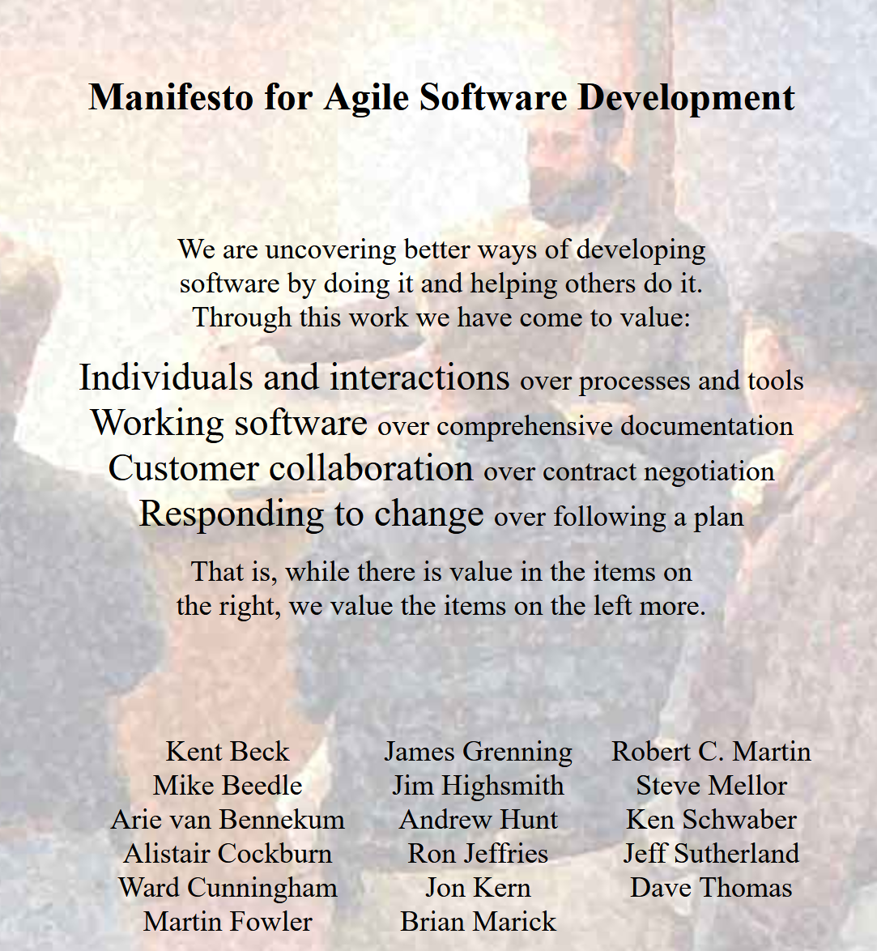
Agile Manfiesto Website
Notes:
https://agilemanifesto.org/

Slide 14
The Agile Manifesto and Core Values
Individuals and interactions over processes and tools
Working software over comprehensive documentation
Customer collaboration over contract negotiation
Responding to change over following a plan
Notes:
Individuals and interactions -- communication and collaboration.
Working software -- delivering tangible results (however, does not mean no documentation)
Customer collaboration -- continuous customer involvement.
Responding to change -- adaptability and flexibility
Value in items on the right
Value in items on the left matters more

Slide 15

Key Agile Principles and Practices -- Iterative and Incremental Development
Don’t develop the entire system in one attempt
Break the project down into small, manageable components to be worked on later
Develop each subset of those components in short, iterative cycles (sprints)
Sprints should be 1 – 4 weeks in duration
Goal: deliver software incrementally
Try to have a minimally viable product (MVP) early on
Notes:
Hopefully, we get to a substantially more viable project later on
Iterative – we will go through the software development lifecycle (planning, design, coding, testing, deployment) within each iteration
Incremental: This means that with each iteration, a working and potentially shippable piece of functionality (an increment) is added to the product.
Delay decisions as long as possible, prioritize items most important to the team
The product grows feature by feature, increment by increment.
Revisit and refine the product repeatedly, like sculpting.

Slide 16
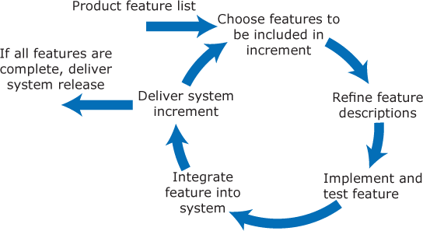
Key Agile Principles and Practices -- Iterative and Incremental Development

Slide 17

Key Agile Principles and Practices -- Iterative and Incremental Development
Why does it matter?
Early delivery of value
Frequent opportunities for feedback
Reduces the risk of building the wrong product,
Allows the team to learn and adapt based on what they build and user feedback.
Notes:
Hopefully, we get to a substantially more viable project later on
Iterative – we will go through the software development lifecycle (planning, design, coding, testing, deployment) within each iteration
Incremental: This means that with each iteration, a working and potentially shippable piece of functionality (an increment) is added to the product.
The product grows feature by feature, increment by increment.
Revisit and refine the product repeatedly, like sculpting.

Slide 18

Key Agile Principles and Practice: Cross-functional, Self-organizing Teams
Cross-functional teams are key to the successful implementation of agile
Need frontend/backend/whole stack developers, testers (QA), designers (UI/UX), project managers, domain experts, and analysts
No siloed teams of folks from one area (e.g., a separate requirements team, a design team, a development team, a testing team)
Should be self-organizing – should have autonomy and responsibility to decide the best way to perform their work to complete goals for the current sprint
Notes:
teams decide the best way to accomplish their work.
The importance of regularly reviewing what's working and what's not and making adjustments.
Shippable Increment:** The goal of each iteration is to produce working software that could be released.
Sometimes folks implement Agile through Scrum, Kanban, or Extreme Programming (XP)
Self-organizing -- They figure out how to manage their tasks, who does what, and how to collaborate effectively.
Contrast: In traditional or command-and-control structures, work is often assigned top-down by project managers or leads.

Slide 19

Key Agile Principles and Practices: Cross-functional Self-organizing teams
Why does it matter?
Reduce dependencies on external teams
Streamline communication
Empower the team to make timely, but thoughtful decisions
Foster a sense of ownership over the project/product
Self-organizing teams will be motivated, engaged, and innovating (in theory)
Notes:
Members on self-organizing teams are closer to the work
Can make more informed decisions about how to tackle technical challenges and manage their workflow efficiently.
Management's role shifts from dictating tasks to providing support, removing impediments, and setting clear goals.

Slide 20

Key Agile Principles and Practices – Inspect and Adapt
Core feedback loop in Agile
Inspect process, product, and team dynamics
Make adjustments to adapt
How to do so?
Daily standups – Short daily meetings (10-15 minutes) to describe progress and barriers and to synchronize activities
Have iteration (sprint) reviews – Demonstrate the working product to stakeholders and gather feedback
Have retrospectives – Team meets internally to discuss what went well in the last iteration, what could be improved, and how to make those improvements

Slide 21

Key Agile Principles and Practices – Inspect and Adapt
Why does inspecting and adapting matter?
Allows the team to learn from mistakes
Refine their approach
Ensure the team is headed in the right direction with the product and their collaboration

Slide 22

Key Agile Principles and Practices – Potentially Shippable Increment
The goal is to have a working, tested, and integrated piece of software
Should work reasonably well when tested by clients, end-users, or other key stakeholders
Should be theoretically releasable (at least an MVP)
Does not have all planned features early on; should have all must-haves and most should-haves at/near the end of the full development schedule
Quite simply, each delivered increment should add value for clients and end-users
In Waterfall, the client and end users would have a working product only at the end of the development process

Slide 23
Key Agile Principles and Practices – Potentially Shippable Increment
Why does having potentially shippable increments matter?
Ensures technical debt is managed
Integration issues are found early
Regressions are caught
The team is always ready to deliver value (small wins at every stage, leading to success)
Issues discovered late in the development process, like with Waterfall, are costly to fix

Slide 24
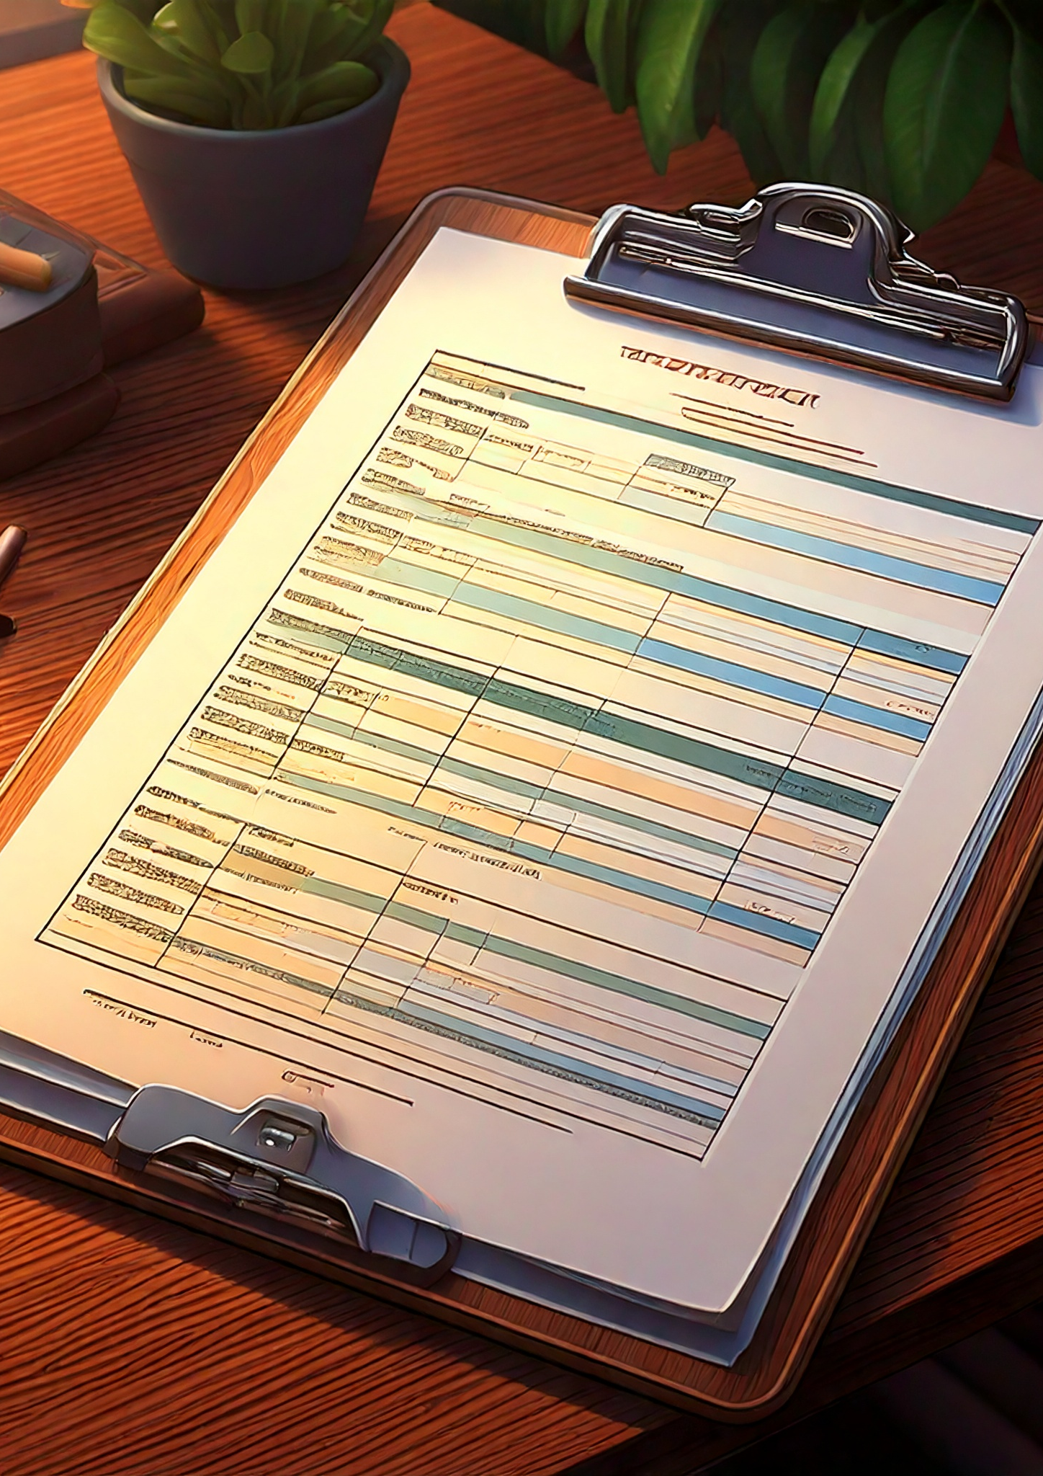
Key Agile Principles and Practices – Prioritization
Scope is often flexible within iterations
Prioritization is needed as a result
Teams need guidance on features, requirements, stories, etc., that are the most important to the business/user to work on at a time
Recommend a formal user requirements process and an organizational method for those requirements, like MoSCoW
Why? So, the team is always working on the highest-value items, maximizing ROI for each iteration, and minimizing scope creep
Notes:
May need to discuss tradeoffs when there are constraints on time/personnel available.

Slide 25
MoSCoW Method
Must Haves
Should Haves
Could haves
Won’t haves
Notes:
Perform an exercise using MoSCoW method

Slide 26

Student Participation Time ☺
What are some user requirements we might have in a command-line slide extractor program? (MoSCoW method)
We’ll consider this product-focused development ☺?
We’ll sell our product into the Microsoft app store 🤣or on our website.
Notes:
Show your silly slide extractor project

Slide 27

Must Have
Command-line Input: The program must accept command-line arguments, specifying the PowerPoint file path and the desired slides to extract.
Slide Extraction: Must extract specific slides from a PowerPoint presentation based on user input.
Export Format: Must save the extracted slides in a commonly used format (e.g., PNG, JPEG, GIF, or PDF?).
Error Handling: Provide meaningful error messages for missing files, incorrect input formats, or unsupported file types.
Basic Documentation: Include a README explaining how to compile and use the program.

Slide 28
Should Have
1. Batch Processing: Should support processing multiple presentations in one run.
01
Custom Output Directory: Allow users to specify an output directory for extracted slides.
02
Supported Formats: Should handle both .ppt and .pptx formats.
03
Slide Content Filtering: Optionally extract slides containing specific keywords or text
04

Slide 29

Could Have
Metadata Extraction: Could extract metadata (e.g., slide notes, authorship, or timestamps) along with slides.
Styling Options: Could allow users to customize slide appearance (e.g., include watermarks or resize slides).
File Compression: Could provide an option to compress output files into a zip archive.
Multilingual Support: Could support command-line output in multiple languages for better accessibility.

Slide 30

Won't Have
GUI Interface: This project is command-line-focused, so a graphical user interface won't be developed.
Slide Editing Features: Advanced features like editing slide content won't be included.
Cloud Integration: The program won’t support uploading extracted slides to cloud services.

Slide 31
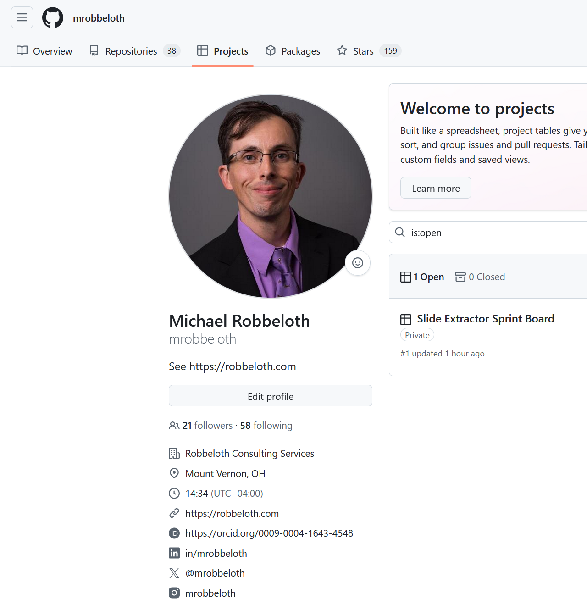
What do we do with these requirements?
Just use the user requirements as is in a minimal documentation process
Add user requirements to a project board with tooling of the development team’s choice
Criticism: ambiguous at this level, especially with/ different stakeholders
Example with GitHub Projects to follow
Could be a whiteboard using writable magnet strips instead, or an enterprise software development tool
Notes:
Recall Agile Manifesto
We are uncovering better ways of developing software by doing it and helping others to do it. Through this work, we have come to value:
individuals and interactions over processes and tools;
working software over comprehensive documentation;
customer collaboration over contract negotiation;
responding to change over following a plan.
While there is value on the items on the right, we value the items on the left more.
https://github.com/mrobbeloth?tab=projects

Slide 32
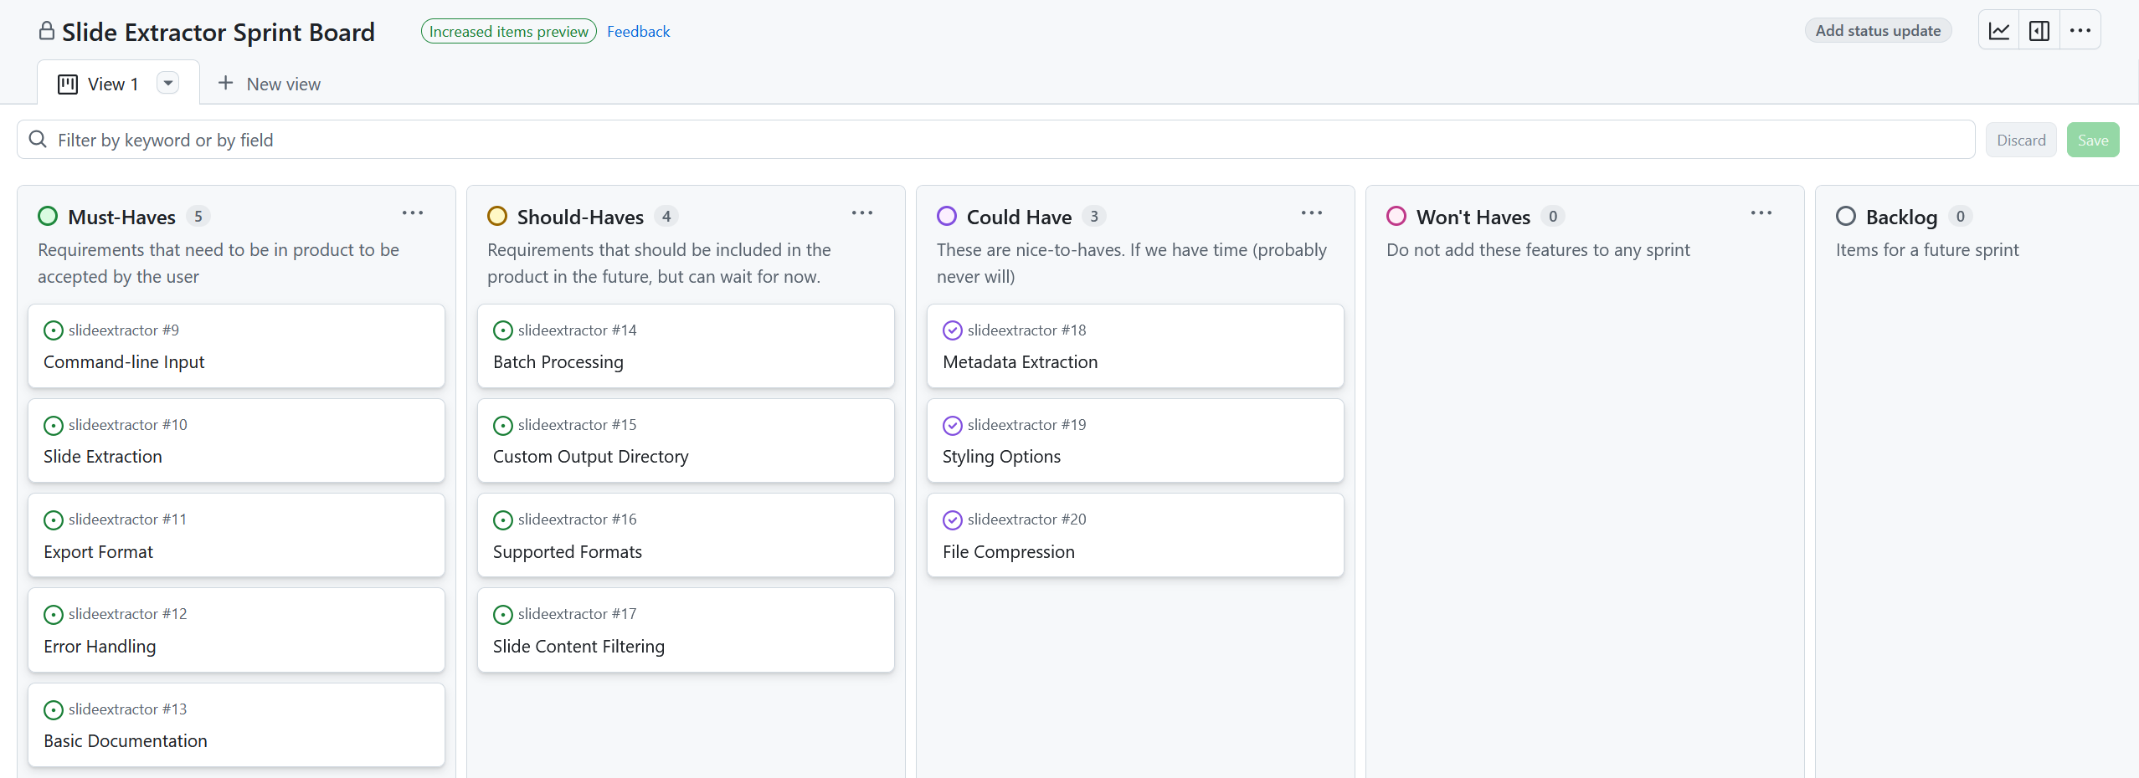
Notes:
Board View
https://github.com/users/mrobbeloth/projects/1/views/1 By tying into the issues system, it allows for verification and traceability.

Slide 33
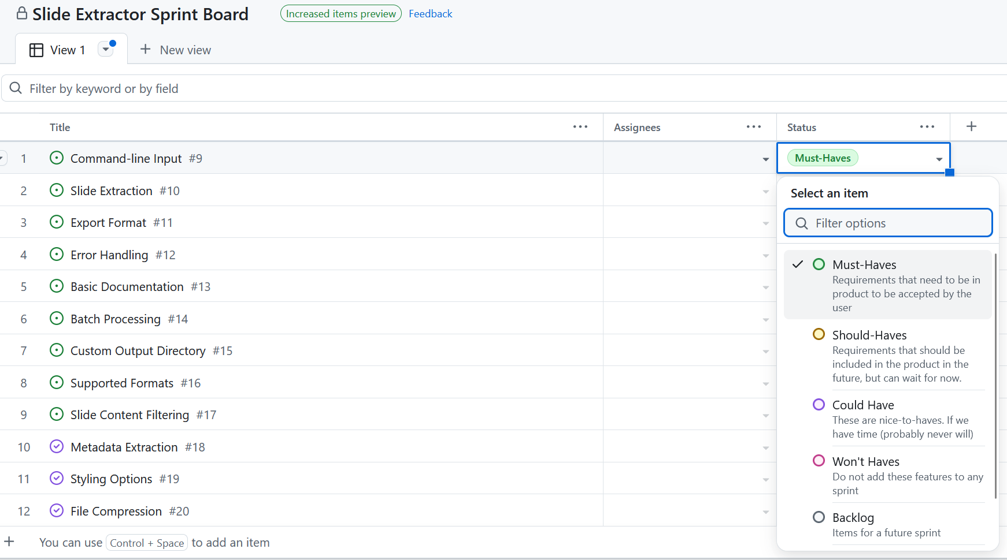
Notes:
Table View
https://github.com/users/mrobbeloth/projects/1/views/1?layout=table

Slide 34

Benefits of Agile
Increased flexibility and adaptability to change.
Faster delivery of value to customers.
Improved communication and collaboration.
Higher customer satisfaction.
Better team morale.

Slide 35

Challenges of Agile
Requires a significant cultural shift.
Can be challenging with distributed teams (though tools help).
Requires active stakeholder involvement.
Estimation can be tricky initially.
There is still a potential for scope creep if not managed well.

Slide 36
Challenges of Agile
May not be appropriate for certain types of projects that:
Require formal contracts with requirements spelled out
Those utilizing formal verification techniques
Projects utilizing real-time, embedded systems with the potential to hurt or kill end-users or otherwise cause catastrophic damage
Large-scale system of systems development with geographically dispersed teams (could use modified agile processes)
In general, business may find a hybrid approach of traditional and agile methods to be appropriate
Notes:
Think about aerospace or government, one-off customized systems for example
Overhead is justifiable for critical systems where the work of several development teams must be coordinated and different people may maintain and update the software during its lifetime.
Detailed documents describing the software requirements and design are important when informal team communications are impossible.
Agile at Scale – Team Scrum w/ role replication, product architects, release alignment, and scrum of scrums

Slide 37

Conclusion
Agile lets us move away from traditional, plan-driven methods when flexibility in development is required
We are replacing rigid processes with ones that value individuals and interactions, working software, customer collaboration, and responding to change.
Our goals with agile are to always deliver incrementally better software that cumulatively adds value for the end users and client
I would encourage you to look at various Agile related methodologies like Scrum or Kanban
Notes:
Agile not as the only way, but as a dominant and highly effective approach in modern software development,
particularly for projects with uncertain or changing requirements.
I believe a knowledge of Agile can complement your knowledge of foundational software engineering principles and methodologies.
It provides a framework for how teams can apply those principles effectively in a dynamic setting.
Again, hybrid approaches (combining aspects of traditional and Agile) are also common.

Slide 38

Questions?

Slide 39
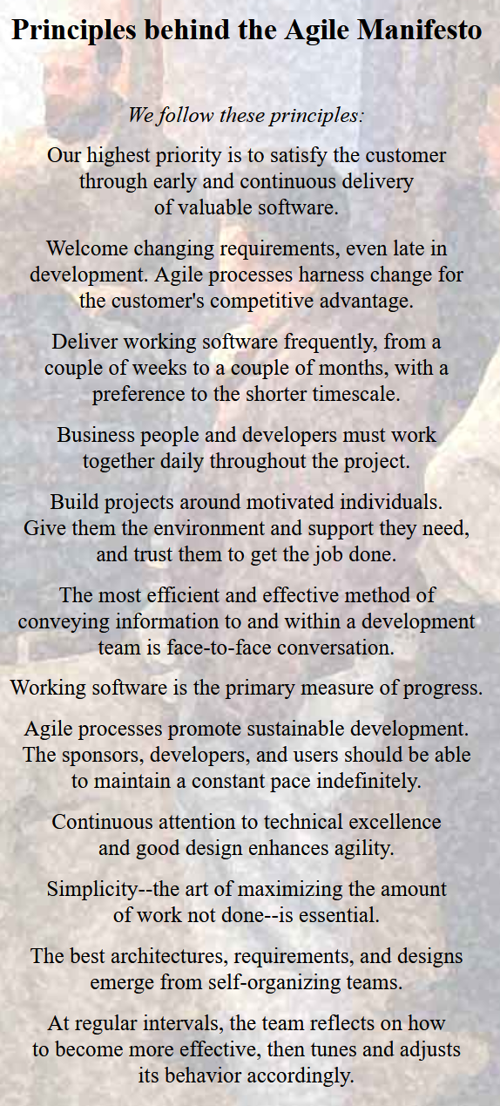
Appendix – Principles of Agile Manifesto

Slide 40

Appendix – Pragmatic Programmer
Notes:
https://pragprog.com/titles/tpp20/the-pragmatic-programmer-20th-anniversary-edition/
They are a Software Engineering practitioner publishing company now!

Slide 41
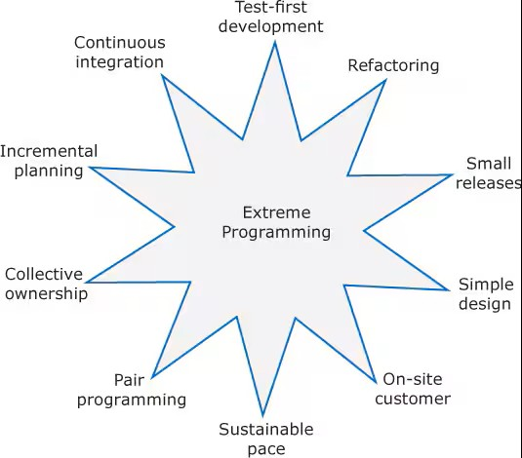
Appendix – Extreme Programming
Notes:
Refactoring, TDD, Pair Programming, User Stories – TDD/Pair Programming not used so much these days.
Credit: Engineering Software Products An Introduction to Modern Software Engineering by Ian Sommerville
Incremental planning/ user stories: There is no “grand plan” for the system. Instead, what needs to be implemented (the requirements) in each increment are established in discussions with a customer representative. The requirements are written as user stories. The stories to be included in a release are determined by the time available and their relative priority.
Small releases: The minimal useful set of functionality that provides business value is developed first. Releases of the system are frequent and incrementally add functionality to the previous release.
TDD: Instead of writing code and then tests for that code, developers write the tests first. This helps clarify what the code should actually do and that there is always a “tested” version of the code available. An automated unit test framework is used to run the tests after every change. New code should not “break” code that has already been implemented
Continuous integration: As soon as the work on a task is complete, it is integrated into the whole system and a new version of the system is created. All unit tests from all developers are run automatically and must be successful before the new version of the system is accepted.
Refactoring: improving the structure, readability, efficiency, and security of a program. All developers are expected to refactor the code as soon as potential code improvements are found. This keeps the code simple and maintainab

Slide 42
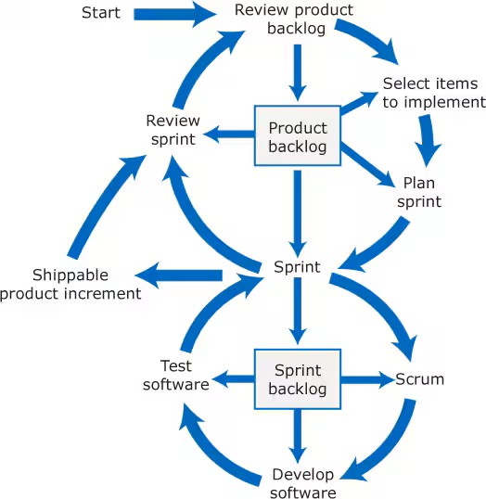
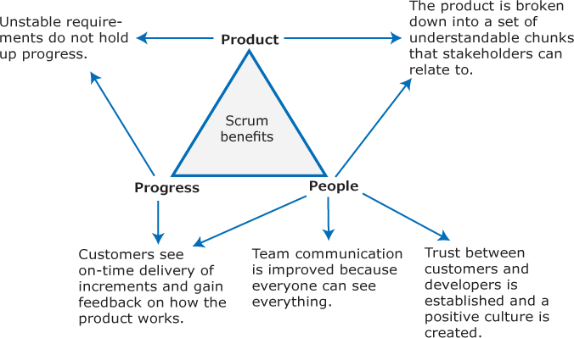
Appendix – Scrum
Notes:
Credit: Engineering Software Products An Introduction to Modern Software Engineering by Ian Sommerville
Incremental planning/ user stories: There is no “grand plan” for the system. Instead, what needs to be implemented (the requirements) in each increment are established in discussions with a customer representative. The requirements are written as user stories. The stories to be included in a release are determined by the time available and their relative priority.
Small releases: The minimal useful set of functionality that provides business value is developed first. Releases of the system are frequent and incrementally add functionality to the previous release.
TDD: Instead of writing code and then tests for that code, developers write the tests first. This helps clarify what the code should actually do and that there is always a “tested” version of the code available. An automated unit test framework is used to run the tests after every change. New code should not “break” code that has already been implemented
Continuous integration: As soon as the work on a task is complete, it is integrated into the whole system and a new version of the system is created. All unit tests from all developers are run automatically and must be successful before the new version of the system is accepted.
Refactoring: improving the structure, readability, efficiency, and security of a program. All developers are expected to refactor the code as soon as potential code improvements are found. This keeps the code simple and maintainab

